Slide 1



Malaria interventions
21-08-2025
Billy Bauzile, Swiss TPH

Slide 2
Review

Slide 3


Basic concepts of Malaria Modeling: transmission cycle
Time: 0
Time: 1
Time: 2
Time: n
Courtesy of Emilie Pothin
Notes:
Purpose:
understand and predict the spread of malaria,
evaluate interventions,
and inform policy decisions.
importance of modeling in combating diseases.

Slide 4
Models help us understand complex interactions that are difficult to study in real-world settings.
Compartmental models:
Susceptible-Infected-Susceptible
Key parameters:
Transmission rate (β)
Recovery rate (γ)
Time
β
susceptible humans
infectious
humans
γ

Slide 5
Models help us generalize behaviors of a system beyond the few instances that we can measure
Time: 0
Time: 1
Time: 2
Time: n
what can be said of this outbreak?
Courtesy of Emilie Pothin
Notes:
Purpose:
understand and predict the spread of malaria,
evaluate interventions,
and inform policy decisions.
importance of modeling in combating diseases.

Slide 6
Models help us generalize behaviors of a system beyond the few
instances that we can measure
Key parameters:
Transmission rate (β)
Recovery rate (γ)
Time
what can be said of this outbreak?
Notes:
What else can make less sick?

Slide 7


The R0: is the …..
expected number of secondary cases produced by a single (typical) infection in a completely susceptible population
R0 is a dimensionless number and not a rate
for a SIS:
for a SITS:
Notes:
It is usually defined as the infection process over the recovery process in simple models

Slide 8
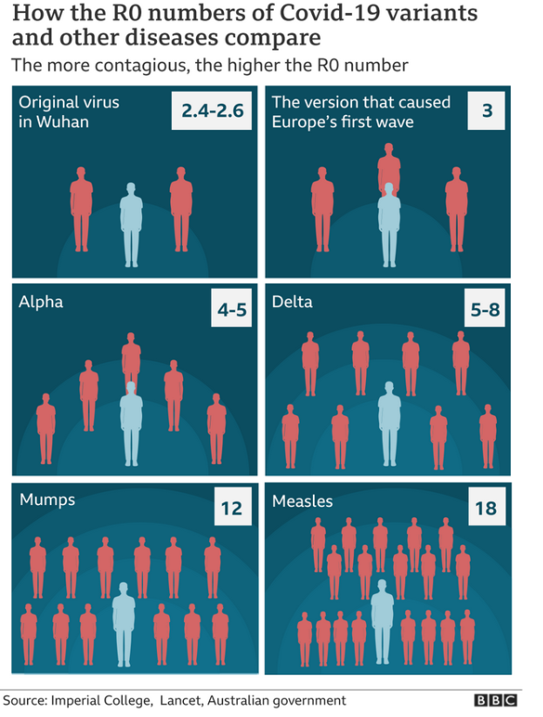
R₀ estimates
What is the R₀ of Malaria?
Smith et al. (PLoS Biol. 2007) estimate it between 1 and 3000 !!
But: Malaria has a long generation time (people can be infectious during more than 100 days)
🡪 less rapid spread compared to airborne viruses
🡪 a lot of infections happen on already infected people
(so it’s not directly comparable)

Slide 9
recovery
susceptible humans
infectious
humans
SIS
transmission
Notes:
We build a malaria transmission model: combine SIS for humans

Slide 10
Assumptions
Hypothesis A: Individuals become immediately also infectious upon infection
Hypothesis B: There are no births or deaths in the population, there is no migration.
Hypothesis C: Once an individual recovers, it will become immediately susceptible again
Hypothesis D: All susceptible hosts are equally likely to meet an infected host.
Hypothesis E: ….
recovery
susceptible humans
infectious
humans
transmission
Notes:
HTe assumption we are making

Slide 11
death
susceptible mosquitoes
infectious mosquitoes
SI
birth
birth
death
Notes:
We build a malaria transmission model: combine SIS for humans with SI for vectors. mosquitoes are assumed to be only female adult mosquitoes (who are taking blood meals).

Slide 12
Mathematical modeling
recovery
susceptible humans
infectious
humans
SIS
transmission from humans to mosquitoes
transmission from mosquitoes to humans
death
susceptible mosquitoes
infectious mosquitoes
SI
birth
birth
death

Slide 13
SIS-SI model
recovery
susceptible humans
infectious
humans
SIS
transmission from humans to mosquitoes
transmission from mosquitoes to humans
death
susceptible mosquitoes
infectious mosquitoes
death
SI
birth
birth
birth
birth
death
death
Notes:
we put names and parameters on the transitions, birth for mosquitoes is important here, as vector lifetime is about 20d but host lifetime is much longer…we need vital dynamic for vectors

Slide 14
Assumptions
Hypothesis A: Individuals become immediately also infectious upon infection
Hypothesis B: Once an individual recovers, it will become immediately susceptible again
….(same for a SIS plus )
Hypothesis C: Mosquito population as constant; birth = death rate
Hypothesis D: Mosquito population does not recover
Hypothesis E: No vertical transmission in the mosquito population
Notes:
HTe assumption we are making

Slide 15
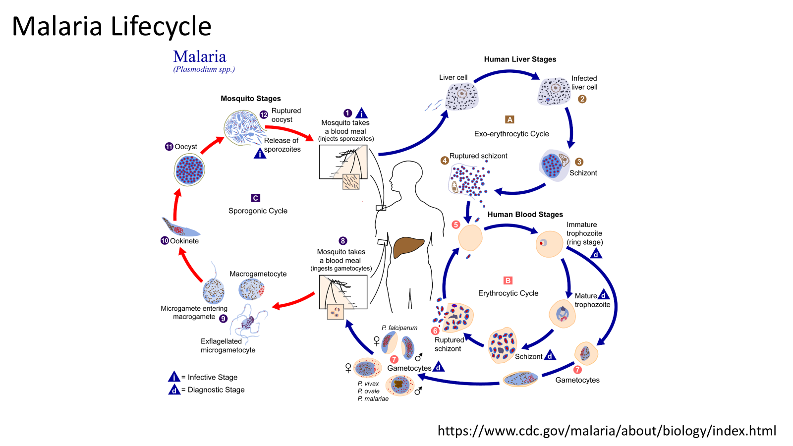
~ 7-30 days
no sign of symptomes
~ few minutes
~ 7-100 days
sign of symptomes
Notes:
~ 30 min after biting by an infected mosquitoes to the liver

Slide 16
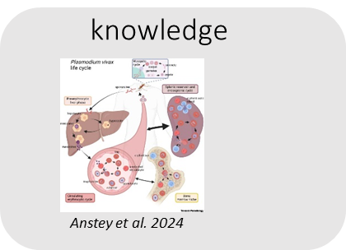
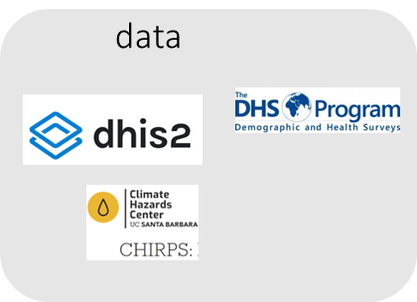
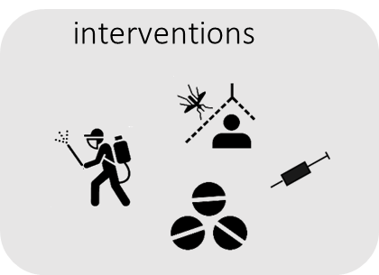
… but we are not completely helpless in facing these threats
we have

Slide 17
Intervention modelling
By the end of this lesson, you will be able to:
Simulate an intervention in the models seen previously
  treatment, etc.
Know how to analyze intervention impact on disease dynamics
Notes:
integrate malaria modeling heterogeneity

Slide 18
Malaria transmission is determined by multiple factors
(drivers of transmission)
Vector
Interventions
Timing of deployment
Biting behaviour
Frequency of deployment
Feeding behaviour
Coverage/Utilization
Vector density
Malaria Transmission and Burden
Seasonality
Attrition
Resistance
Target population/area & demography
Access to healthcare services
Type of parasite
Population mobility
Adherence of the patient
Diagnostic sensitivity
Resistance to treatment
Population density
Efficacy of the drug
Health system and treatment-seeking behavior
Parasite
Others

Slide 19
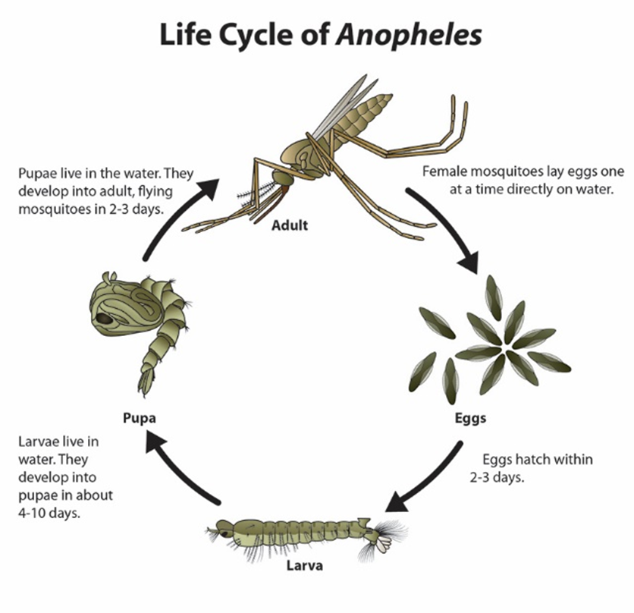
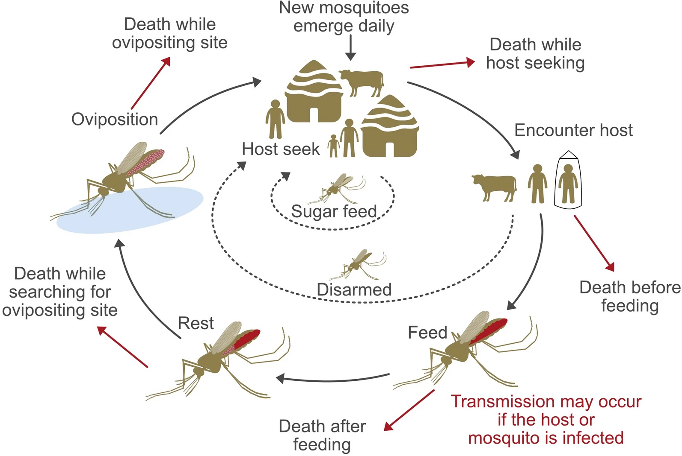
Malaria transmission is determined by multiple factors
(drivers of transmission)
Understand the dynamic between vector and the host
larviciding source management (LSM)
Optimizing malaria vector control in the GMS region … by Wang Y. et al. 2024
Notes:
why am I telling you all of this?

Slide 20
Why do mosquitoes bites us?
Gonotrophic cycle
(feeding cycle)
Optimizing malaria vector control in the GMS region … by Wang Y. et al. 2024
Notes:
what else do we know?

Slide 21
Malaria transmission dynamic
recovery
susceptible humans
infectious
humans
How do SIS differ from SIS-SI model?
recovery
susceptible humans
infectious
humans
In the context of malaria, which one of the model do you think would be more suitable for understanding how how people are getting infected?
transmission from humans to mosquitoes
transmission from mosquitoes to humans
death
susceptible mosquitoes
infectious mosquitoes
birth
birth

Slide 22
Why adding age-structure important?
Age is a critical factor in disease dynamics:
Susceptibility: Children and the elderly are often more susceptible to infection.
Contact Patterns: People tend to interact more with individuals in their own age group (e.g., children in schools, adults in workplaces).
Disease Severity & Recovery: The severity of a disease and the rate of recovery can vary significantly with age.
Mortality: Natural death rates are inherently age-dependent.

Slide 23
Age-structure model: two approaches
Ordinary differential equations
Partial differential equations
Divide the SIS into discrete age groups:
  e.g. over and under 5
transmission pattern
  contact matrix
    who acquires infection from whom?
    heterogeneous mixing
  population weighted contact rates
S, I are depend of both time and age
Continuous age structure
transmission pattern
  transmission kernel
How do you choose which approach to use?
Limited computational resources available
Policy focus on specific age-targeted interventions
Parameter estimation is primary goal
Rapid model development needed
High age resolution is scientifically important
Theoretical analysis is the primary objective
Smooth age-dependent processes are key to the biology
Long-term dynamics where artificial age boundaries matter
Notes:
worth simply it in to reduce complexity,
when

Slide 24
SITS modeling
treatment impacting infected individual
transmission
infectious
Treatment
susceptible
natural recovery rate
treatment rate
transmission
susceptible
infectious
treatment is reducing the rate of transmission
recovery
transmission
SIS model
susceptible
infectious
natural recovery
SITS model

Slide 25
SITS modeling
remission rate
transmission
infectious
Treatment
susceptible
natural recovery rate
treatment rate
transmission
susceptible
infectious
transmission
recovery
SIS model
susceptible
infectious
Treatment may act on:
infected individual
reducing the rate of transmission
natural recovery
SITS model
Notes:
when would we be interested in one rather than the other formulation of the model?

Slide 26
It’s coding time!!!

Slide 27
Assumptions
Hypothesis A: Individuals become immediately also infectious upon infection
Hypothesis B: There are no births or deaths in the population, there is no migration.
Hypothesis C: The model has demographic dynamic
Hypothesis D: Once an individual recovers, it will become immediately susceptible again
Hypothesis E: All susceptible hosts are equally likely to meet an infected host.
Hypothesis F: Under 5 population has a different transmission rate than those in over 5 population
Hypothesis G: ….
Notes:
HTe assumption we are making

Slide 29
Scenario analysis
Practical 1
At one of the UoN student housing (500 students), a stomach bug is observed every few weeks.
Sick students feel awful for about 10 days, then they’re fine and back to class.
The school nurse notices: students who were sick a month ago get sick again.
Outbreaks kick off fast: if someone vomits in a tiny study room, others feel ill by the next day. At the beginning of the academic semester, 1 sick student in the residence was found exhibiting these symptoms. It was later discovered that this disease has a transmission rate of 0.4.
Tasks
Identify the compartments and draw the flow diagram.
Would the outbreak die out?
  Compute R0. what is the value?
Using your model, simulate the numbers of students in each compartment over 365 days.
How many students are in each compartments after 10 days, 6 months

Slide 30
Scenario analysis
Practical 2
scenario 2
From practical 1, In order to help students avoid missing out on their classes, the school nurse administers a fast-acting treatment. The drugs available for treatment are not enough to treat all the students and therefore only 60% of sick students get the treatment. Students who receive the treatment (get it a rate tau) are able to return to class after 3 days (instead of the 10 days previously without treatment). A study found that the rate at which infected students are able to get treatment is 0.05 per day.
Tasks
What change does this new information make to your model in practical 1?
Create a new flow diagram to reflect this change
Compute the R0. What can we say about about the outbreak?
Using your new model, simulate the numbers of students in each compartment.
After 6 months how many students in each compartments?

Slide 31
Scenario analysis
Practical 3
scenario 3
From practical 1, what are some of the measures we can put in place to decrease the transmission rate?
How can we implement these measures in our model?
Using your new model, simulate the model over 365 days.
What is the prevalence after 2 months of infection?
what is the incidence at 70 days
what is the phenomenon observed after 3 months?

Slide 32
Scenario analysis
Practical 4
scenario 4
In this scenario, we would like to implement both the treatment and the measures to decrease transmission rate (ie. combine practical 2 and 3) to produce a new model
  Using your new model, simulate the numbers of infected and susceptible students over time for 365 days

Slide 33

Acknowledgements
Christian Selinger
Emilie Pothin
Cameline Orlendo
Zenabu Suboi
Geoffrey Githinji
Merci Beaucoup!
Thank you!
Mèsi anpil!
Asante sana!
billy.bauzile@swisstph.ch
Obrigado!

Slide 34
Lecture 11

Slide 35
SIS-SI model
recovery
susceptible humans
infectious
humans
SIS
transmission from humans to mosquitoes
transmission from mosquitoes to humans
death
susceptible mosquitoes
infectious mosquitoes
SI
birth
birth
birth
death
death
Notes:
we put names and parameters on the transitions, birth for mosquitoes is important here, as vector lifetime is about 20d but host lifetime is much longer…we need vital dynamic for vectors

Slide 36
Tutorial
At the start of the rains in a village of one thousand people, about five mosquitoes buzz around each person. Ten villagers are already infectious with a vector borne disease, and about two percent of the mosquitoes carry the parasite. In humans, the average infection period is about twenty five days, after which individuals become susceptible immediately.
Mosquitoes live only around ten days, bite humans at a rate of 0.3 bites per day, host seeking at rate of 0.01, and a bite has an infectivity of 0.03. Once a mosquito is infected, it stays infectious until they die. Records suggest that an infectious person infects susceptible mosquitoes at a daily rate of 0.45, while the transmission rate from infectious humans to mosquitoes at a rate of 0.5.
Simulate the dynamic of the model for 365 days. What is the population in each compartment at time 10 and 180 days.
We now have look at scenarios where we have the following interventions in the model:
reduce biting rate by forty percent,
treatment reduces the average human infectious period from twenty five to ten days,
that would combine both interventions

Slide 37
SIS-SI model - Tutorial
recovery
susceptible humans
infectious
humans
SIS
transmission from humans to mosquitoes
transmission from mosquitoes to humans
death
susceptible mosquitoes
infectious mosquitoes
death
SI
birth
birth
birth
birth
death
death
Notes:
we put names and parameters on the transitions, birth for mosquitoes is important here, as vector lifetime is about 20d but host lifetime is much longer…we need vital dynamic for vectors

Slide 38


SIS-SI model - Tutorial
alpha = biting rate* seeking * infectivity
recovery
susceptible humans
infectious
humans
SIS
= 0.5
transmission from humans to mosquitoes
transmission from mosquitoes to humans
= 0.00009
death
susceptible mosquitoes
infectious mosquitoes
SI
birth
birth
death
Notes:
we put names and parameters on the transitions, birth for mosquitoes is important here, as vector lifetime is about 20d but host lifetime is much longer…we need vital dynamic for vectors

Slide 39
SIS-SI model - Tutorial
alpha = biting rate* seeking * infectivity
recovery
susceptible humans
infectious
humans
SIS
= 0.5
transmission from humans to mosquitoes
transmission from mosquitoes to humans
= 0.00009
death
susceptible mosquitoes
infectious mosquitoes
Vector control
SI
Vector control
birth
Vector control
birth
death
Notes:
we put names and parameters on the transitions, birth for mosquitoes is important here, as vector lifetime is about 20d but host lifetime is much longer…we need vital dynamic for vectors

Slide 40
Age-structured modeling
transmission
susceptible 1
infectious 1
recovery
transmission
aging
susceptible
infectious
transmission
recovery
SIS model
susceptible n
infectious n
recovery
SIS model
Time

Slide 41






Malaria transmission model with vector control
recovery
susceptible humans
infectious
humans
transmission from humans to mosquitoes
transmission from mosquitoes to humans
death
susceptible mosquitoes
Vector control
infectious mosquitoes
birth
Vector control
Vector control
birth
death
Notes:
What can we do to decrease prevalence? Vector control? It will increase the death rate of mosquitoes

Slide 42

Age-structured modeling
transmission
susceptible 1
infectious 1
recovery
transmission
aging
susceptible
infectious
transmission
recovery
SIS model
susceptible n
infectious n
recovery
SIS model
Time

Slide 43

Equation of the model
: human population in age group j, ( )
M : total mosquito population.
: susceptible and Infected human population in age group j, respectively
: birth of new susceptible individuals, only into the first age group (j=1).
: natural death rate for age group j.
: aging rate (transition from age group j to j+1).
Notes:
Because we are adding age,

Slide 44
Equation of the model
: human population in age group j, ( )
M : total mosquito population.
: susceptible and Infected human population in age group j, respectively
: birth of new susceptible individuals, only into the first age group (j=1).
: natural death rate for age group j.
: aging rate (transition from age group j to j+1).
Notes:
Because we are adding age,

Slide 45


Mosquito population dynamic
Let be the mosquito birth rate, ​ be the mosquito death rate, and a be the mosquito biting rate.
Where:
is the total mosquito population.
is the total infected human population (for all age group).
is the total human population (for all age group).
The force of infection from infected humans to mosquitoes can be defined as:

Slide 46
Malaria transmission: age structure
Mosquitoes
Human
birth
recovery
susceptible
under 5
infectious
under 5
susceptible mosquitoes
death
6 ordinary Differential Equations (ODEs)
transmission
birth
transmission
infectious mosquitoes
susceptible
over 5
infectious
over 5
recovery
SIS model
death

Slide 47

Malaria transmission model with treatment intervention
recovery
susceptible humans
infectious
humans
j = 1 : under 5
j = 2 : over 5
transmission from humans to mosquitoes
transmission from mosquitoes to humans
death
susceptible mosquitoes
infectious mosquitoes
Vector control
birth
Vector control
birth
death
Notes:
What can we do to decrease prevalence that is affecting age-group differently?
parameters to modified the transmission to the different age group

Slide 48


Practical 10
SIS-SI host-vector model with vector control
We want to run and compare two simulations in R:
simulation 1 as in the slides
simulation 2 starts from simulation 1, but adds an intervention that would control as an 20% increase in the default mosquito mortality rate , all other parameters are kept the same
compare the endemic equilibrium of infected hosts between simulation 1 & 2
Notes:
Practical in R: we implement vector control as stated. We compare two simulations. Simulation 1 without vector control, simulation 2 with 20% increase in mortality.

Slide 49
SIS-SI
info on how to build sis-si
parameters
task 1. implement vector (decrease susceptible and infected mosquitoes)
task 2. implement mass drug administration
task 3. both 1 and 2

Slide 50
Scenario analysis
tutorial 1
scenario 3 (combination)
cases averted
which scenario would you recommend?

Slide 51
Acknowledgements
Christian Selinger
Emilie Pothin
Cameline Orlendo
Zenabu Suboi
Geoffrey Githinji
billy.bauzile@swisstph.ch

